Slide 1
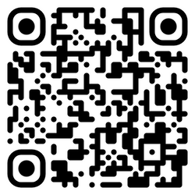
RSVP no later than noon on Monday, October 28 with the QR code below
NOVEMBER 1, 2024
WOMEN'S
lunch
Employer Panel with Q&A!
Thank you Terracon & Corning
for Sponsoring the lunch!
SAC SALONS A&B
11:00AM ~ 12:30PM

